Slide 1
Module No 4
UiPath Application Automation

Slide 2
Learning Objective
Advanced practices with Studio
Advances UI Interaction Introduction
Selectors Introduction

Slide 3
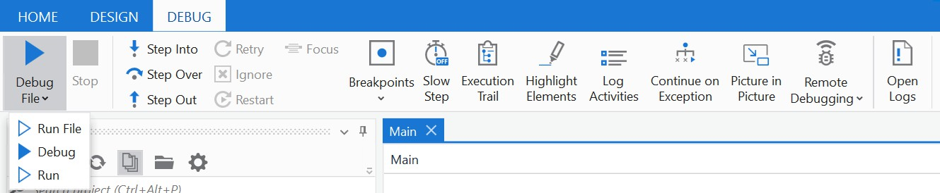
Debugging
Debugging is the process of identifying and removing errors that prevent the project from functioning correctly.
During the design stage of the automation project, at activity, file and
project level.
Debug can be executed from both Design or Debug tabs.
Debug current file

Slide 4
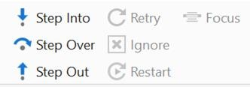
Debugging Actions
Debugs activities one by one. Opens the workflows in “Invoke Workflow File” activities.
Re-executes the previous activity, and throws the exception if it's encountered again.
Step Over
executes all inside a
Ignores an encountered exception and continues the execution from the next activity.
activities
container without opening
the container.
Completes the execution of activities in the current container and then pauses the debugging at the current container level.
Restarts the debugging process
from the first activity of the
project.

Slide 5
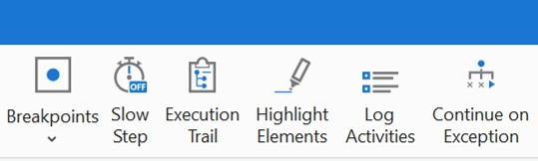
Debugging Actions
Breakpoints: Places a breakpoint to selected activity to pause the debug execution.
Slow Step: Debugs at slower speeds and highlights each step of the execution flow.
Execution Trail: Shows the exact execution path at debugging.
Highlight Elements: UI elements are highlighted during debugging.
Log Activities: Debugged activities are displayed as Trace logs in the Output panel.
Continue on Exception: When enabled, exception is logged in the Output panel and the execution continues.

Slide 6
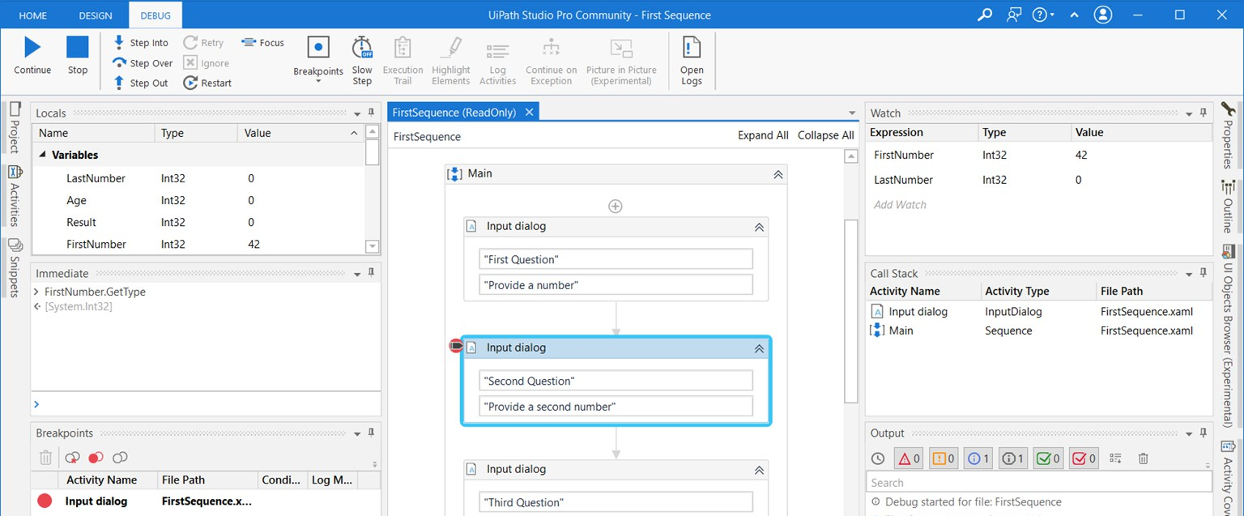
Debugging

Slide 7
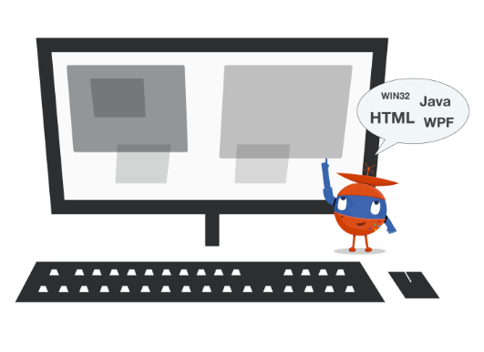
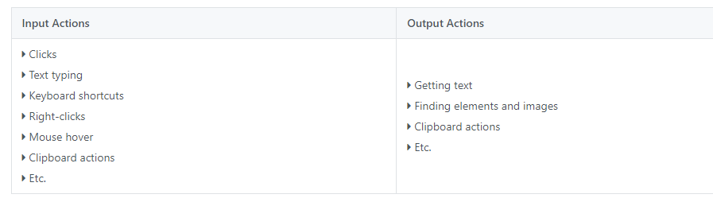
User Interface
User Interface (UI) Elements : All graphical user interface pieces that construct an application, be they windows, checkboxes, text fields or drop-down lists, and so on.
UI Automation: The process of interacting with graphical elements within applications by simulating mouse and keyboard controls.
There are majorly two interactions we can observe in UI Automation
Input: Inserting data into an application
Output: Fetching data from an application or Ui Elements

Slide 8
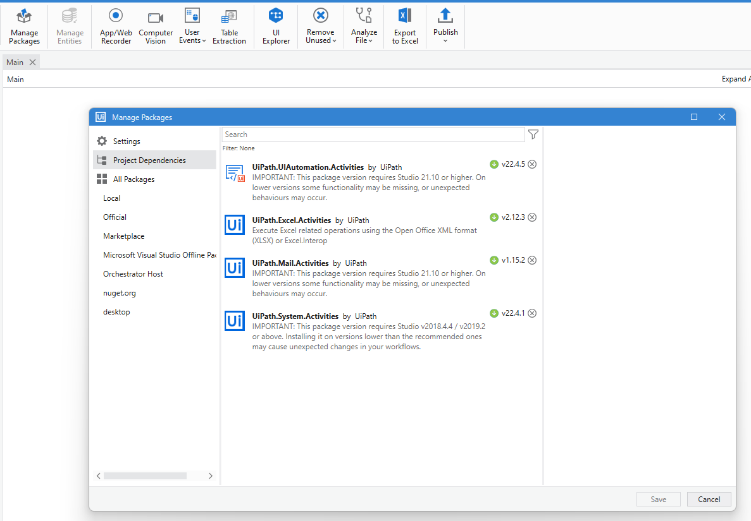
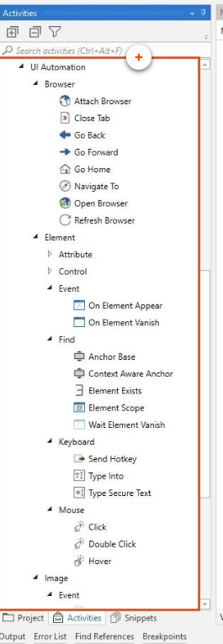
UI Automation Activities
User Interface Activities
Activities can be split into:
Containers - These are activities that identify the browsers or apps the process needs to interact with. All activities included within a Container will execute on the same application. Some examples are Open Browser, Attach Browser, Open Application, or Use Application/Browser
Input Activities - These activities send input to UI elements. They can be used to click, check, type into, send hotkeys, and so on.
Output Activities - get structured data or get UiElements containing images.
Synchronization Activities - They help you create triggers based on UI behavior, thus enabling the Robot to execute certain actions when specific events occur on a machine.
***Latest Package Available in Manage Package Section

Slide 9
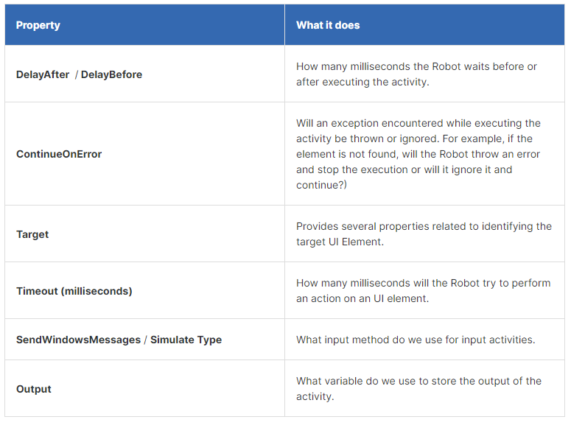

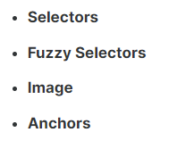
Activity Properties
User Interface Common Properties

Slide 10
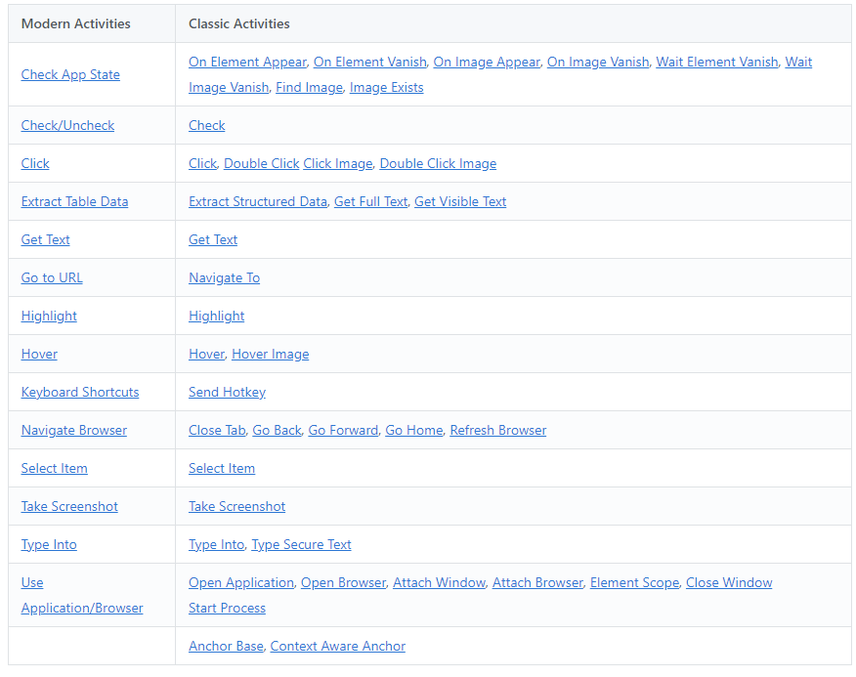
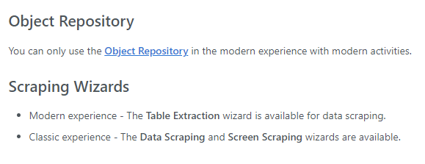
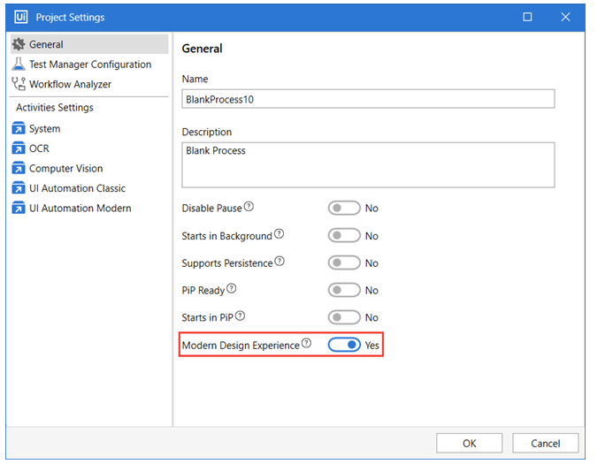
Modern Vs Classic Design Experience
Mordern v/s Classic Activities

Slide 11
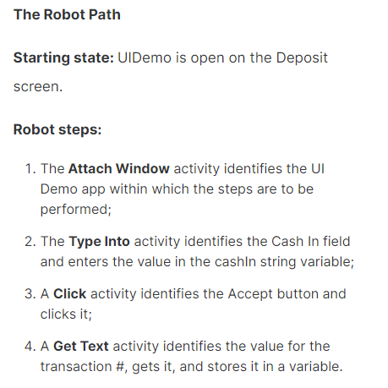
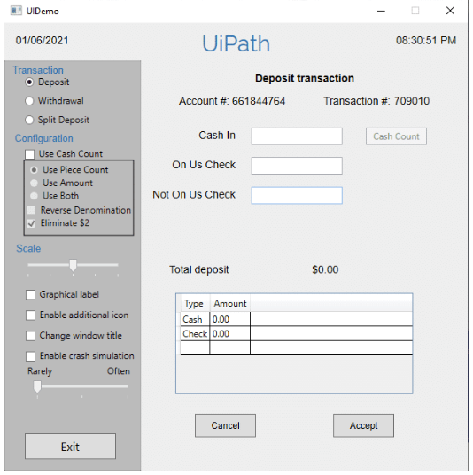
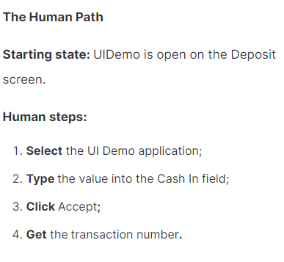
Example 1: UI Demo Application
Enter Data
Open Demo UI Application
Input Actions
Get Transaction Number
Click Accept
Output Actions

Slide 12
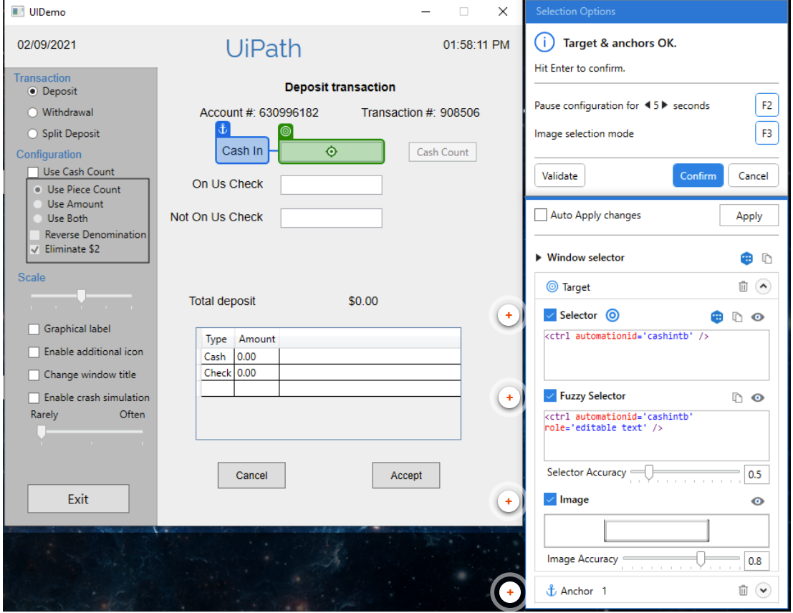
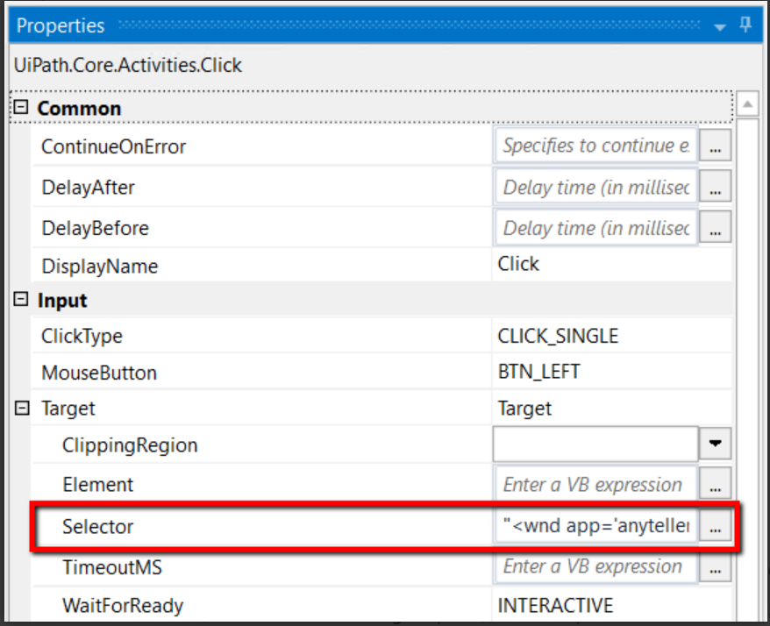
Selectors
Unique identifiers of UI elements. These store UI element attributes which will help identify the UI element uniquely during automation.
Wild cards
There are two types of wildcards available in UiPath
* - Replaces any number of characters.
? - Replaces exactly one character.

Slide 13
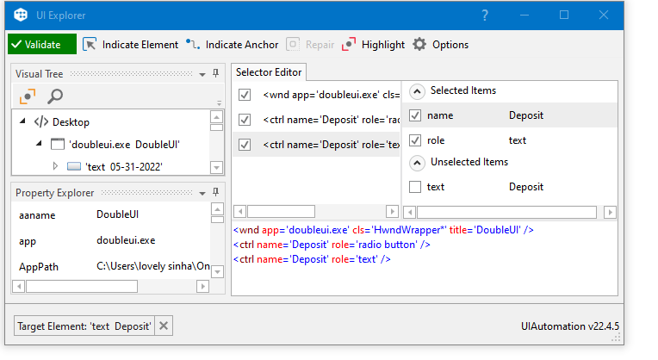
UI Explorer
It is the wizard which is used to indicate and edit selectors. If we are unable to locate the individual element then we can switch to other Ui Frameworks for better results.

Slide 14
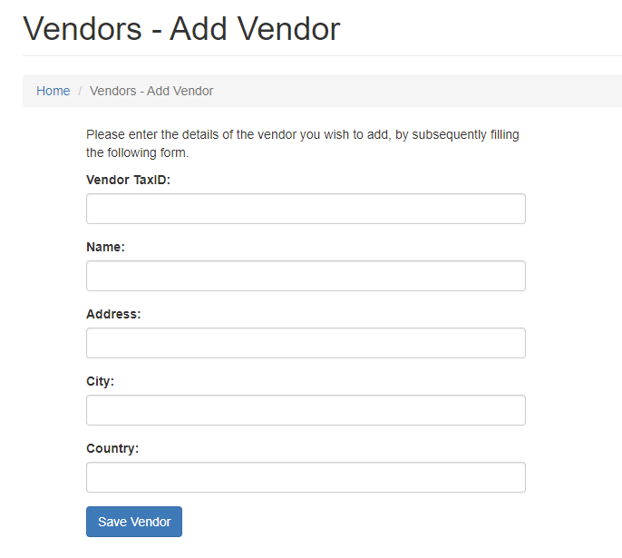
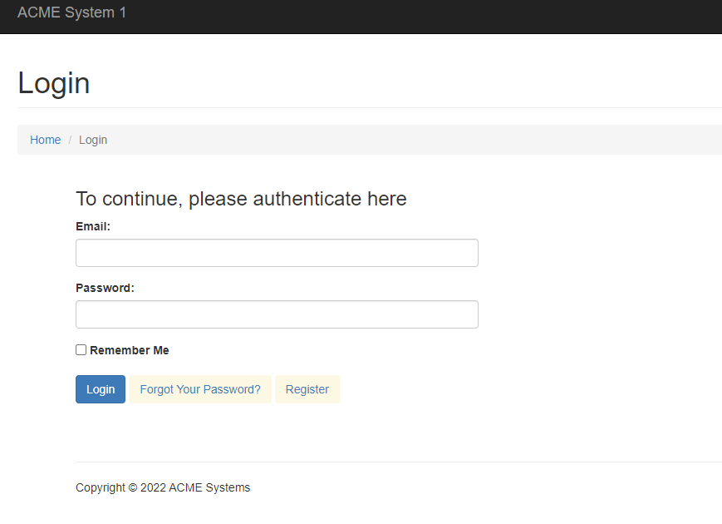
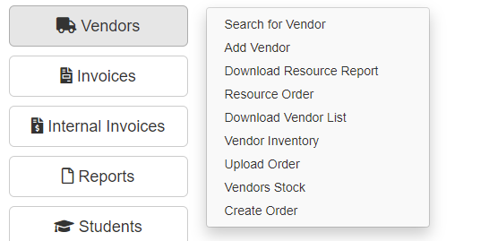
Example 2: ACME Add Vendor
Enter Credentials
Open Browser
https://acme-test.uipath.com/login
Input Actions
Display added vendor details
Click Vendors -> Add Vendor
Output Actions

Slide 15
Takeaways
UI Automation is the process of automating application user interfaces by simulating human input and output actions through specific UI Activities.
The first step in automating UIs is understanding the logical sequence of steps that a human user would take. The second step consists in translating these steps into UiPath Studio Activities and configuring them.
The complexity of the UI or of the application is irrelevant. All desktop/web applications can be automated by using universal or application-tailored activities.

Slide 16
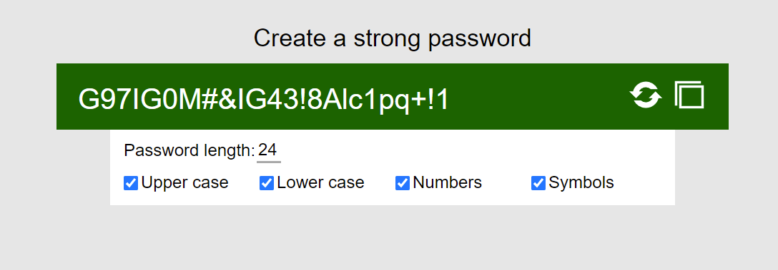
Assignment: Password Generator
Type Password Length
Open Browser and Navigate to URL https://www.rpasamples.com/passwordgenerator
Input Actions
Get Password
Generate Password
Output Actions
Post your Unique 10-digit password with the following hashtags :
#UiPathCommunity
#RPAKickStarter
“My Buddy Bot generated a password – [your password]”

